Slide 1
Credit Card Eligibility
Group 1: JMR
Jacqueline Columbro
Matthew Harper
Rajeev Daithankar
Notes:
Jackie

Slide 2
Project Overview
Analyzed dataset to gain insight into the key factors influencing credit card eligibility and to assess the dynamics of credit card eligibility determination
We chose this project as a result of the increased use of contactless payment, the prevalence of consumers that have credit cards, and because it provides insight into the informed decisions made regarding whom may or may not be eligible for a credit line

Slide 3
Project Goals/Questions Answered
Classification of Credit Card Eligibility
Compare with various models for accuracy

Slide 4
Data Collection
The data we selected for this presentation was sourced from Kaggle:
Credit Card Eligibility Data: Determining Factors
Understanding the Dynamics of Credit Card Eligibility: Insights from a Comprehensive Collection
We would like to acknowledge and thank the author: Rohit Sharma

Slide 5
Approach: Code
Pandas
Sklearn: model selection, preprocessing, standard scaler, label encoder, linear model, logistical regression, SVC, Kneighbors, DecisionTree, RandomForest, ensemble,Adaboost, GradientBoost, Metrics, utils
Numpy
Seaborn
Matplotlib
Scipy.stats
AutoViz
Label Encoder

Slide 6
Ethical, Societal, Sustainability Aspect
Ethical : The data set used by us is available in public domain (Kaggle) and is accessible to anyone. It is not related to any individual or county. It does not contain any PII data.
Societal : The credit card eligibility decision should be fair and unbiased. In this project, we are making sure that ML model is not biased towards any specific group of people.
Sustainability : This project does not have not indirect and/or direct relation to sustainability.
Notes:
Jackie end

Slide 7
No Free Lunch Theorem
There is no model that is a priori guaranteed to work better (hence the name of the theorem).
The only way to know for sure which model is best to evaluate it.
In practice, you make some reasonable assumptions about the data and evaluate a few reasonable model
Reference - https://arxiv.org/abs/2202.04513
Notes:
Rajeev start

Slide 8
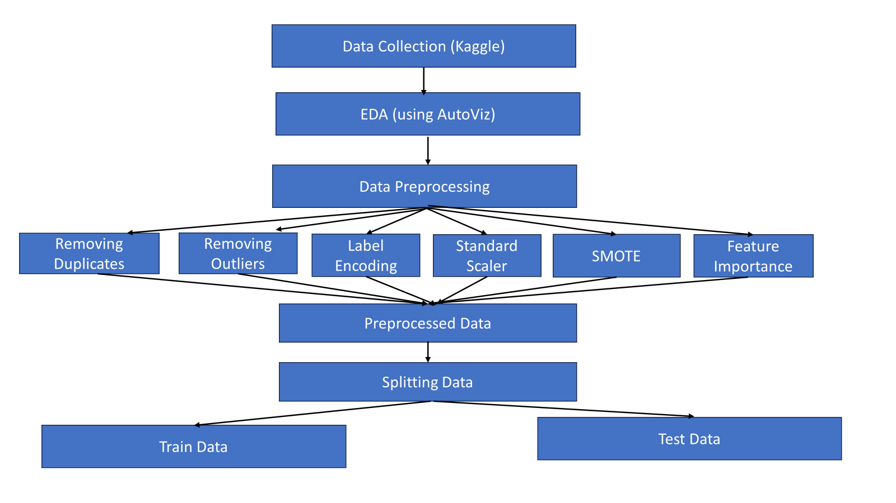
Project Method

Slide 9
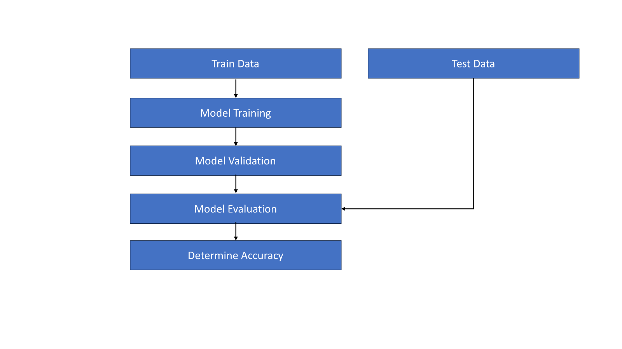
Project Method - contd.

Slide 10
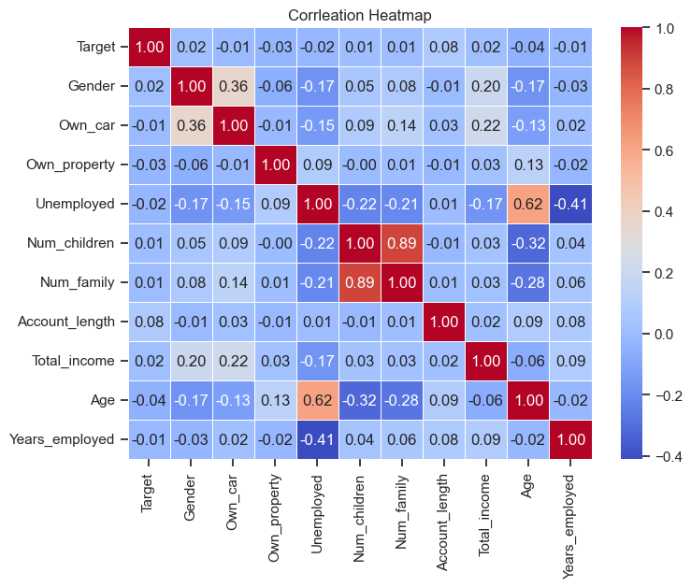
Correction Heatmap
Correlation Coefficients
Target vs Gender 0.02
Target vs Own_car -0.01
Target vs Own_property -0.03
Target vs Unemployed -0.02
Target vs Num_children 0.01
Target vs Num_family 0.01
Target vs Account_length 0.08
Target vs Total_income 0.02
Target vs Age -0.04
Target vs Years_employed -0.01

Slide 11
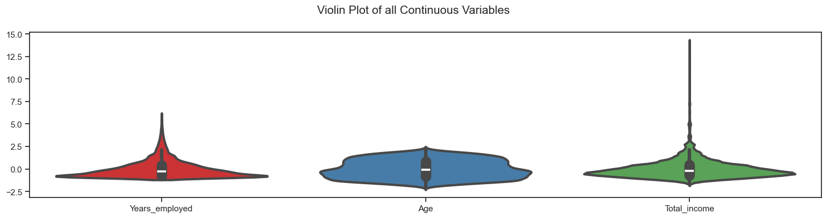
Violin Plot
Notes:
Rajeev end

Slide 12
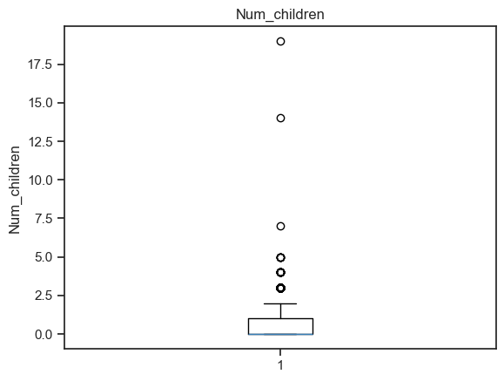
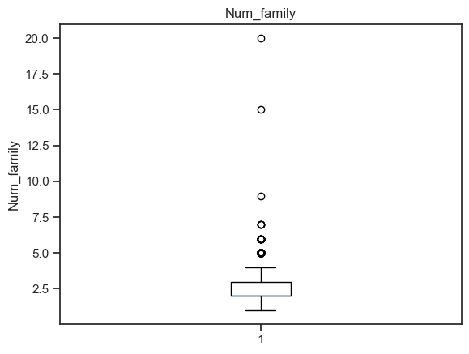
Outliers
The number of children the individual has The total number of family members.
Notes:
Matt start

Slide 13
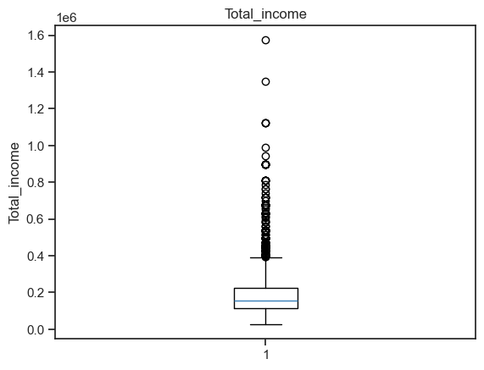
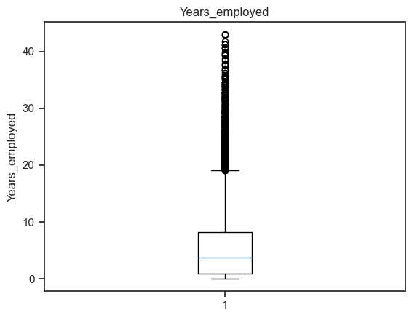
Outliers - condt.
The total income of the individual The number of years the individual has been employed

Slide 14
Data Preprocessing
Label Encoding - Categorical Variables.
columns_to_encode = ["Income_type", "Education_type", "Family_status", "Housing_type", "Occupation_type"]
Standard Scaler : This once of the important transformation for feature scaling
StandardScaler(). Performed on X_train and X_test
SMOTE - We have imbalance y_train. Target- 0 - 6521 , 1-1008
Applied SMOTE to balance classification , Target - 0 - 6521 , 1- 6521

Slide 15
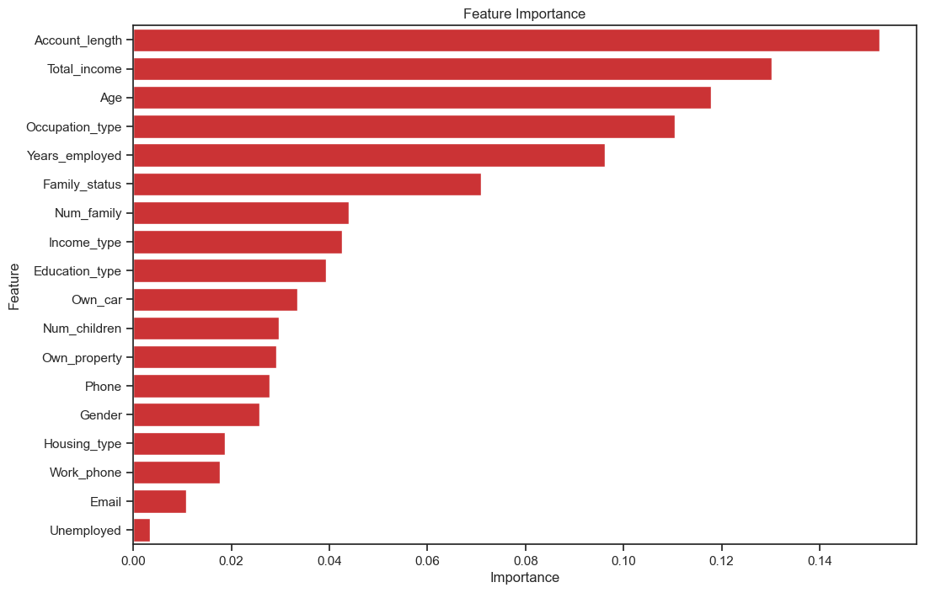
Feature Importance
Top 10 Features
Account_length 0.152151
Total_income 0.130271
Age 0.117826
Occupation_type 0.110467
Years_employed 0.096103
Family_status 0.070909
Num_family 0.043990
Income_type 0.042602
Education_type 0.039308
Own_car 0.033507

Slide 16
Logistic Regression Classifier :
Tuning Parameters
GridSearchCV(cv=5, estimator=LogisticRegression(max_iter=1000),
param_grid={'C': [0.001, 0.01, 0.1, 1, 10, 100], 'penalty': ['l1', 'l2'], 'solver': ['liblinear', 'saga']}
Classification Report :
precision recall f1-score support
1 0.15 0.54 0.24 234
0 0.90 0.57 0.70 1649
accuracy 0.56 1883
macro avg 0.52 0.56 0.47 1883
weighted avg 0.81 0.57 0.64 1883

Slide 17
Support Vector Machine :
Parameter
(kernel='poly')
Classification Report :
precision recall f1-score support
1 0.15 0.52 0.23 234
0 0.90 0.58 0.71 1649
accuracy 0.56 1883
macro avg 0.52 0.55 0.47 1883
weighted avg 0.80 0.57 0.65 1883

Slide 18
Support Vector Machine :
Parameter
(kernel='poly')
Classification Report :
precision recall f1-score support
1 0.15 0.52 0.23 234
0 0.90 0.58 0.71 1649
accuracy 0.57 1883
macro avg 0.52 0.55 0.47 1883
weighted avg 0.80 0.57 0.65 1883

Slide 19
Support Vector Machine :
Parameter
(kernel='poly')
Classification Report :
precision recall f1-score support
1 0.15 0.52 0.23 234
0 0.90 0.58 0.71 1649
accuracy 0.57 1883
macro avg 0.52 0.55 0.47 1883
weighted avg 0.80 0.57 0.65 1883

Slide 20
Decision Tree Classifier
Parameter
(max_depth=6)
Classification Report :
precision recall f1-score support
1 0.14 0.57 0.22 234
0 0.89 0.49 0.63 1649
accuracy 0.50 1883
macro avg 0.51 0.53 0.43 1883
weighted avg 0.80 0.50 0.58 1883

Slide 21
Gradient Booster Classifier - GridSerachCV
Parameters
{'learning_rate': 0.01, 'max_depth': 3, 'min_samples_leaf': 2, 'n_estimators': 100}
Classification Report :
precision recall f1-score support
1 1.00 0.00 0.01 234
0 0.88 1.00 0.93 1649
accuracy 0.88 1883
macro avg 0.94 0.50 0.47 1883
weighted avg 0.89 0.88 0.82 1883

Slide 22
Gradient Booster Classifier - GridSerachCV
Parameters
param_grid = { 'n_estimators': [100, 200, 300], 'max_depth': [None, 10, 20, 30], 'min_samples_split': [2, 5, 10], 'min_samples_leaf': [1, 2, 4] }
GridSearchCV(estimator=RandomForestClassifier(random_state=42),
Classification Report :
precision recall f1-score support
1 1.00 0.00 0.01 234
0 0.88 1.00 0.93 1649
accuracy 0.88 1883
macro avg 0.94 0.50 0.47 1883
weighted avg 0.89 0.88 0.82 1883

Slide 23
Random Forest Classifier - GridSerachCV
Parameters
{'learning_rate': 0.01, 'max_depth': 3, 'min_samples_leaf': 2, 'n_estimators': 100}
Classification Report :
precision recall f1-score support
1 0.18 0.08 0.11 234
0 0.88 0.95 0.91 1649
accuracy 0.84 1883
macro avg 0.53 0.51 0.51 1883
weighted avg 0.79 0.84 0.81 1883

Slide 24
KNN Classifier - GridSearchCV
Parameters
param_grid_KNN = {
'n_neighbors': [1, 3, 5, 7, 9, 11, 13, 15, 17, 19],
'weights': ['uniform', 'distance'],
'leaf_size': [10, 50, 100, 500]
}
GridSearchCV(grid_tuned_model, param_grid_KNN, verbose=3
Classification Report :
precision recall f1-score support
1 0.00 0.00 0.00 234
0 0.88 1.00 0.93 1649
accuracy 0.88 1883
macro avg 0.44 0.50 0.47 1883
weighted avg 0.77 0.88 0.82 1883

Slide 25
KNN Classifier - RandomizedSearchCV
Parameters
param_grid_random = {
'n_neighbors': np.arange(1,20,2),
'weights': ['uniform', 'distance'],
'leaf_size': np.arange(1, 500)
}
RandomizedSearchCV(random_tuned_model, param_grid_random, random_state=0, verbose=3)
Classification Report :
precision recall f1-score support
1 0.00 0.00 0.00 234
0 0.88 1.00 0.93 1649
accuracy 0.88 1883
macro avg 0.44 0.50 0.47 1883
weighted avg 0.77 0.88 0.82 1883

Slide 26
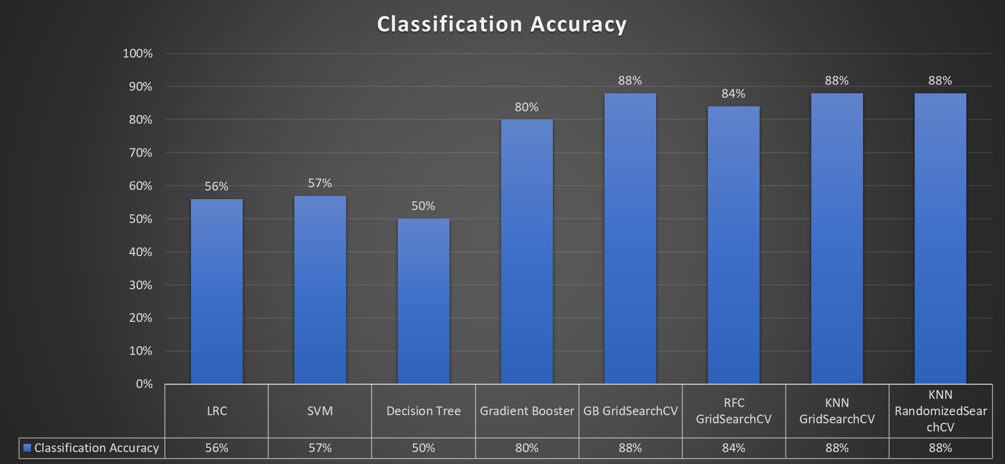
Accuracy Comparison -Summary
Observations:
Tuning model with GridSerarchCV / RandomSerachCV provides better classification accuracy
GradientBoosster and KNN prvoides 88% claissifcation accuracy with GrandientSearchCV/RandomSearchCV
No Free Lunch theorem holds good here
Notes:
Matt

Slide 27
Summary
Through this analysis we aimed to provide insights into how credit card eligibility is determined. The results obtained can serve a variety of entities such as researchers, analysts, and financial institutions as a basis for further insights to the key factors influencing credit card eligibility and to develop predictive model that assist with automating the credit assessment process.
Can improve informed decisions, improve risk assessment, and enhance customer targeting
Notes:
Jackie

Slide 28
Problems Encountered
Tuning Models with GridSearchCV and RandomizedSearchCV with various parameters
Notes:
One of the major disadvantages of grid search is that it can be very time-consuming and computationally expensive,

Slide 29
Future Considerations
Ensemble - Bagging, Boosting Models
Bayesian Optimization
More data
Notes:
Ensemble learning combines multiple machine learning models into a single model. The aim is to increase the performance of the model. Bagging aims to decrease variance, boosting aims to decrease bias, and stacking aims to improve prediction accuracy. Bagging and boosting combine homogenous weak learners.
Bayesian optimization is a sequential design strategy for global optimization of black-box functions that does not assume any functional forms. It is usually employed to optimize expensive-to-evaluate functions. >>> is this optimization better than random search. We can see that the bayesian search outperforms the other methods by a little. This effect is much more noticeable in larger datasets and more complex models

Slide 30
Q & A

